Slide 1
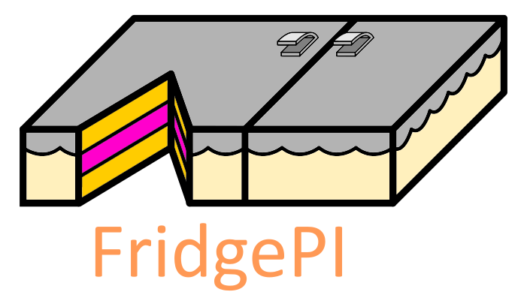
FridgePI
A smart fridge for lazy people
Mobile and Cyber-physical System
25/05/18
Alessandro Fagnani, Federico Rossetto e Silvia Severini
Notes:
Good Morning,
Today we want to show you our project called FridgePI that is a smart fridge that will help you..
Our main goal is to create a smart device for your home that could simplify some everyday activities.
our idea start from..

Slide 2

According to the Time Use Institute, you spend in the supermarket:
More than an hour a week
110 days of your lifetime!!
.. and who knows about the time you spend thinking about what to eat!
Notes:
Let’s start with some statistics:
the Time Use Institute made a survey to understand how much time you spend at the supermarket on average an guess what?!
more than a hour a week
if you do some maths, it means a hundred and 10 days of your life time!!
pretty impressive
and who knows about the time you spend just thinking about what to eat overall!!

Slide 3

What’s in my fridge?
What can I eat for dinner?
Do I need to go to the market?
Notes:
The idea of this project come out also from some common questions that we ask ourself on a daily basis
What’s in my fridge?
Because usually you insert the grocieries in the fridge without paying to much attention
Following
What can I eat for dinner?
for the same reasons
And last but not least
Do I need to go to the market to buy some food or I have everything I need?
Of course to answer, you should remember what you actually have in your fridge and storage units

Slide 4
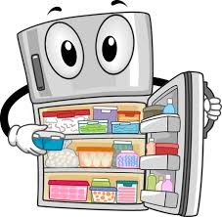
So what?
A fully automated monitoring system!
No overhead for you
Always available everywhere
Always up-to-date
A lot of possible extensions
Notes:
So what? How can we deal with this problem?
We built a fully automated monitoring system for your storages
The core features of our system are:
no overhead for you: you don’t need to write down what you have in the fridge nor to scan the barcode of each product
always available everywhere: you have the list in your web app so always with you
always up-to-date: when you open up the application you can refresh it and have everything ready
a lot of possible extensions: that we have done like the recipes advisors and that we could do later on. for example you can integrate the information that you obtain with other device to make it even smarter

Slide 5
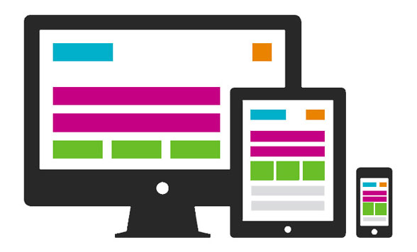

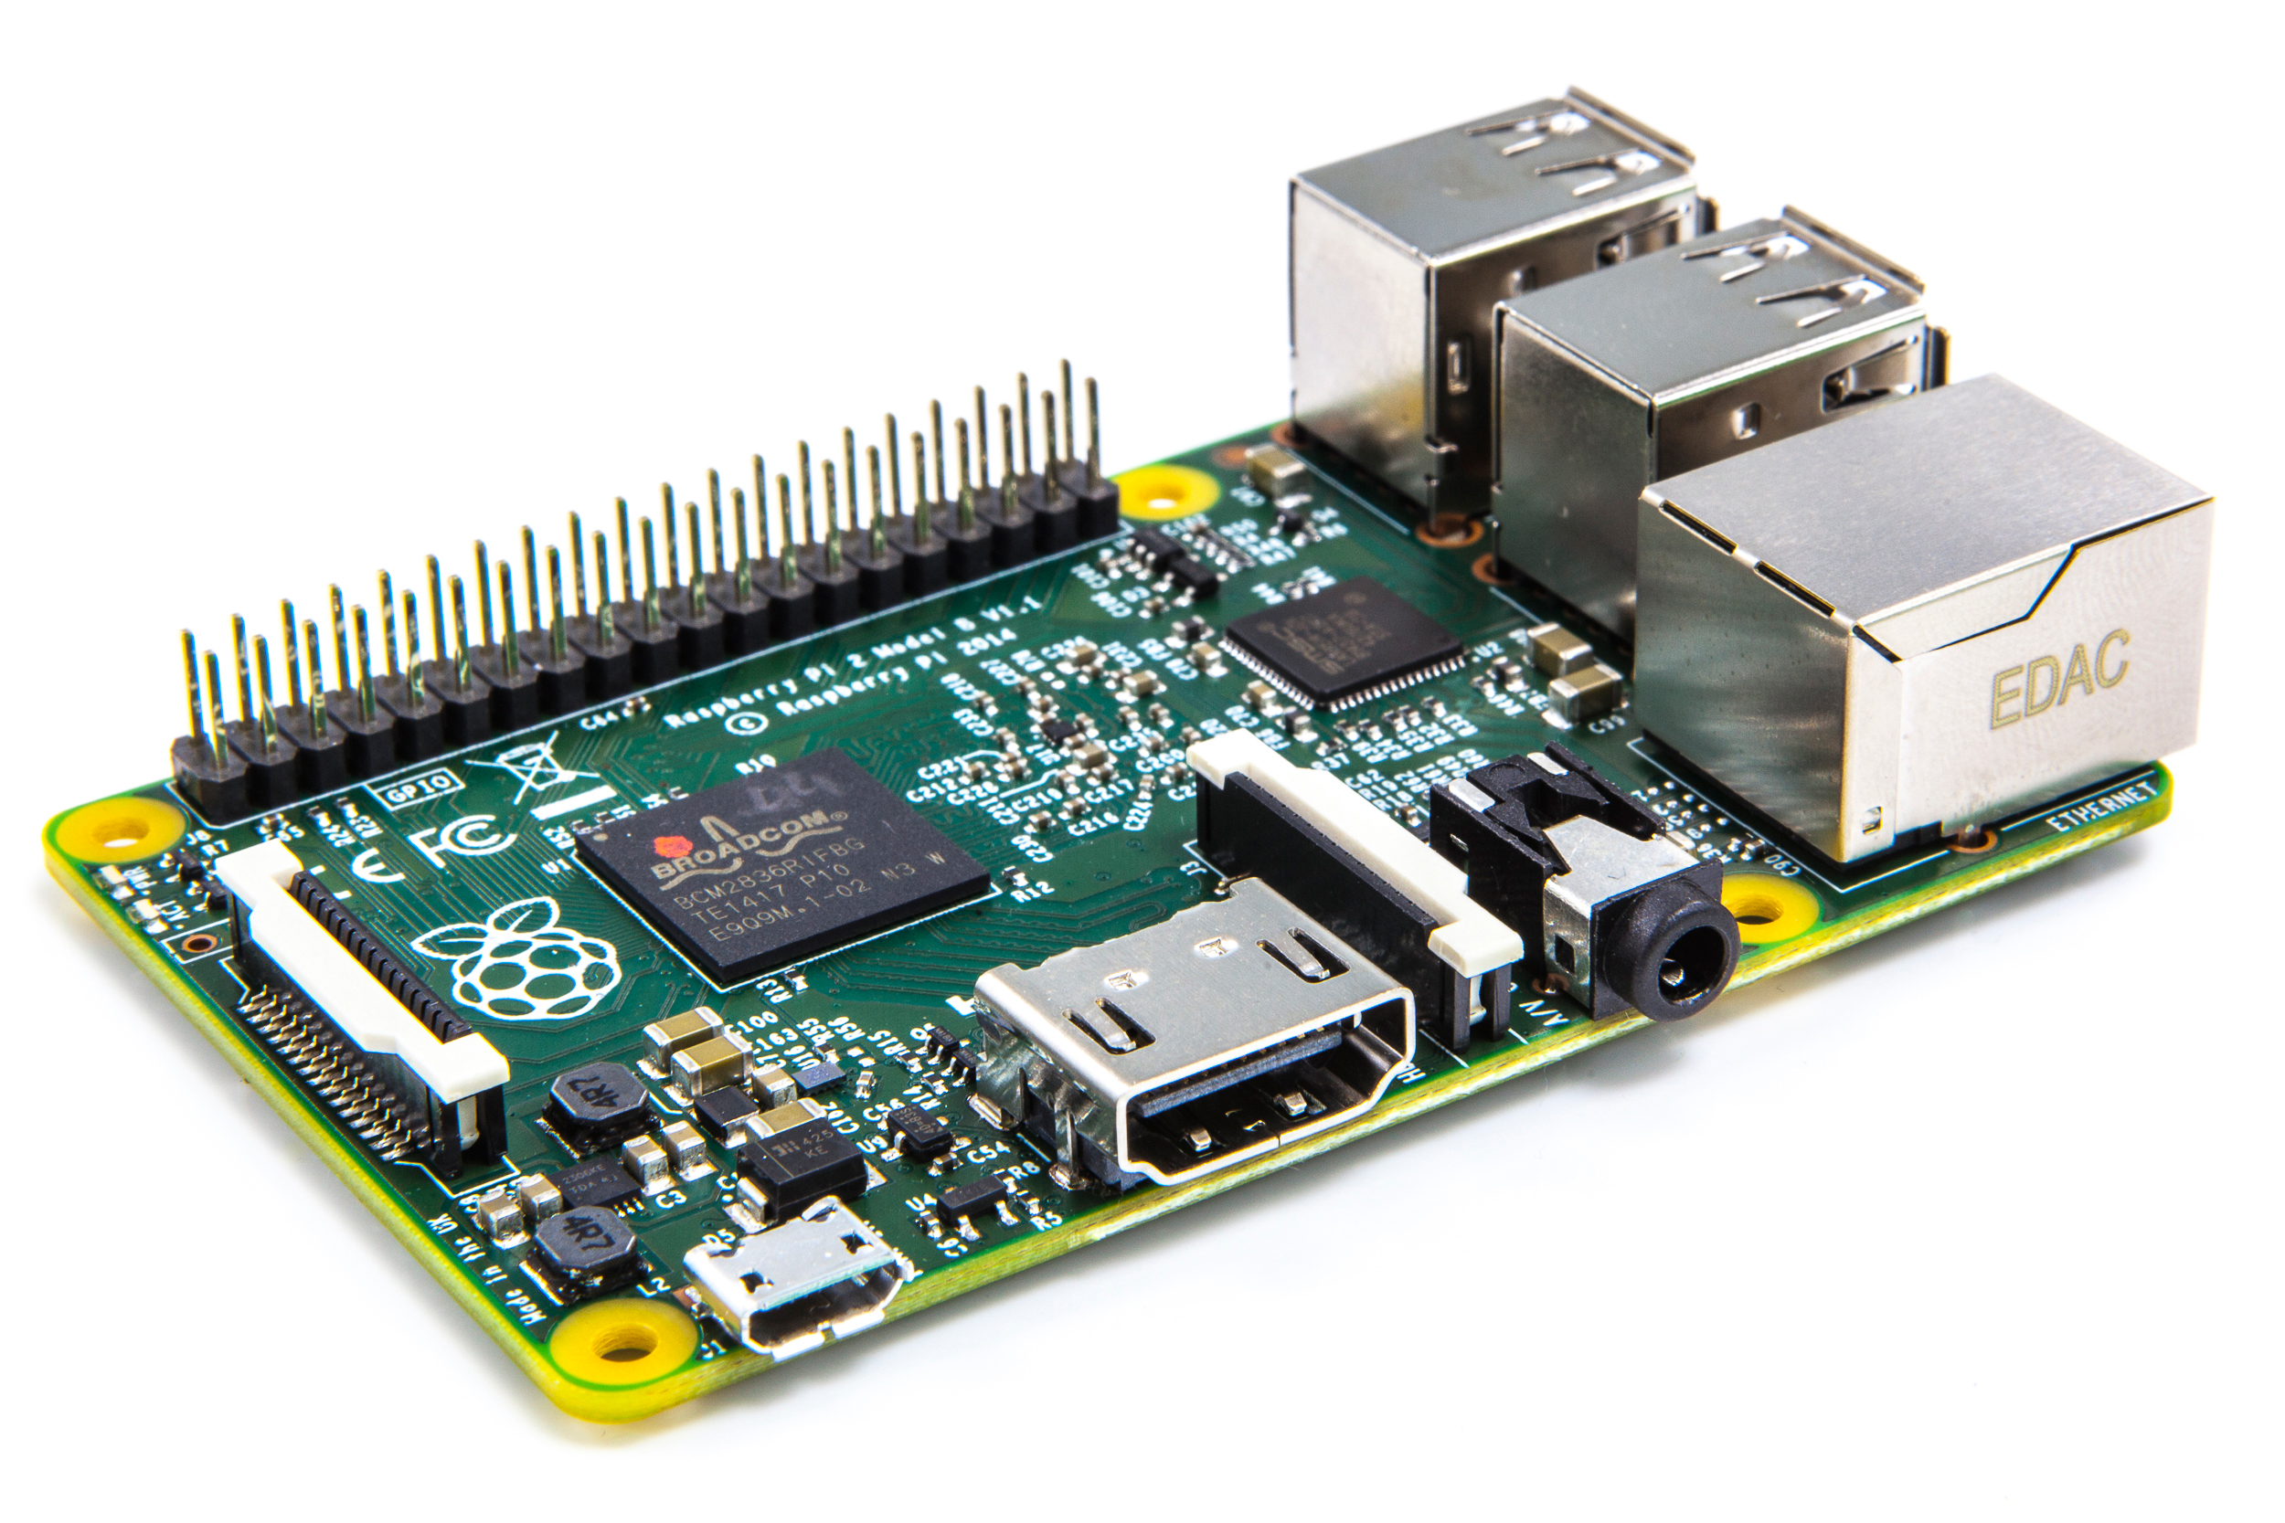

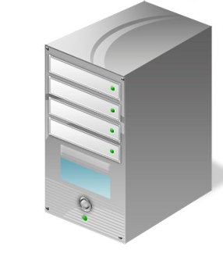




System architecture
HTTP
HTTP
HTTP
HTTP
Notes:
Let’s take a look to the system architecture:
we have a central server that communicates with the raspberry inside the fridge and the client web app
In the fridge there is a raspberry with some other components that we will see in the next slide
The web app is built using the react framework
The server used the TensorFlow library for the image recognition of the products
It also use a database, mLab, to store all the information about the users and the products
Finally it asks the information about the recipes that you can make with the products you have, to the food2fork API
Of course all the communication used the HTTP protocol
-----
The system that we take today is a simple prototype in order to let you have a solid idea of what is capable of. This pc is used as a server, this as router and as you can see a very realistic fridge. And you will see in a moment a live demo.

Slide 6
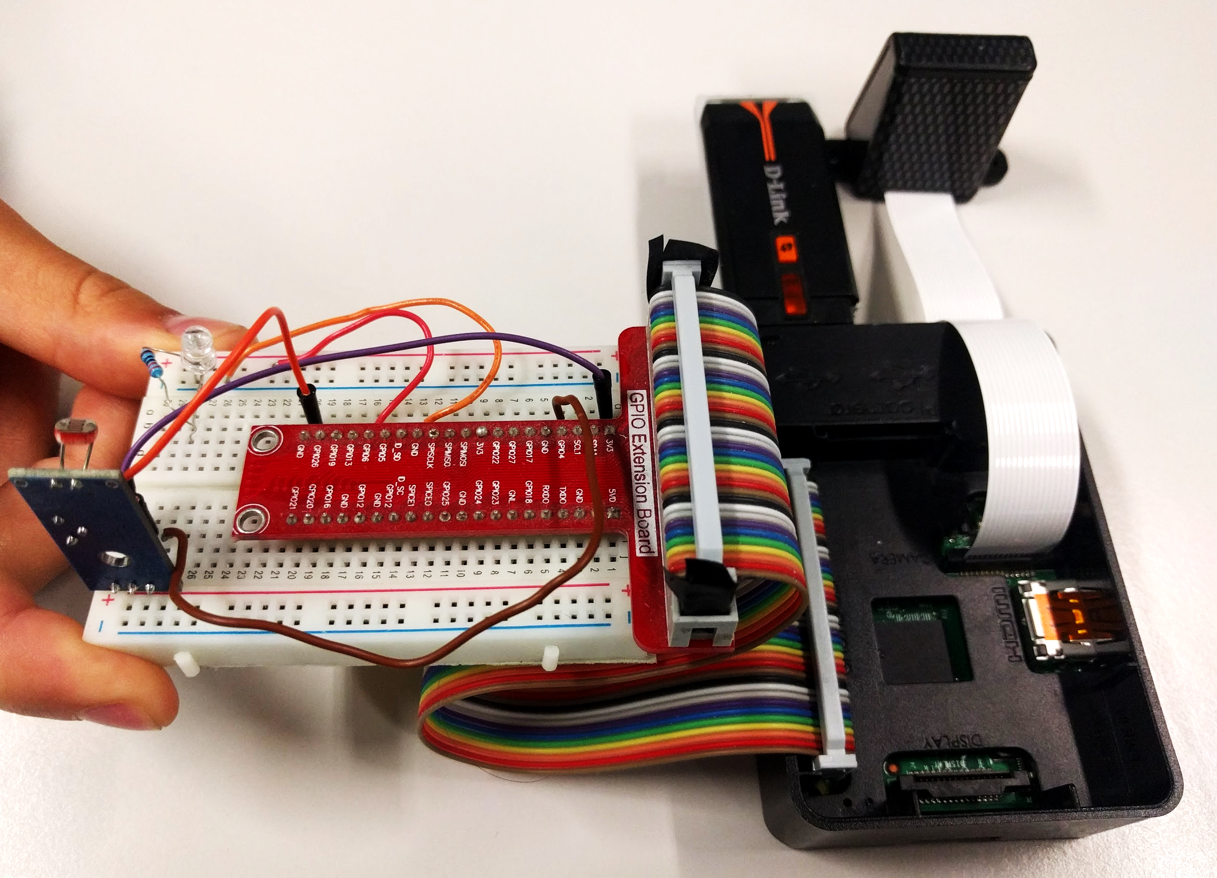
A closer look
PiCamera
White led
Light Sensor
Notes:
Let’s have a closer look to the hardware
-So first of all we have a light sensor used to add the automatic behaviour to take the pictures of the food inside the fridge.
Inside every fridge there is a light when you open the door: that’s the signal to wake up the mechanism.
We assume that everytime person open the fridge, he probably change the status of the inside. So when the person close the door,
the white led, used like a flash, lights up the environment so that the PI cam can take the picture.

Slide 7
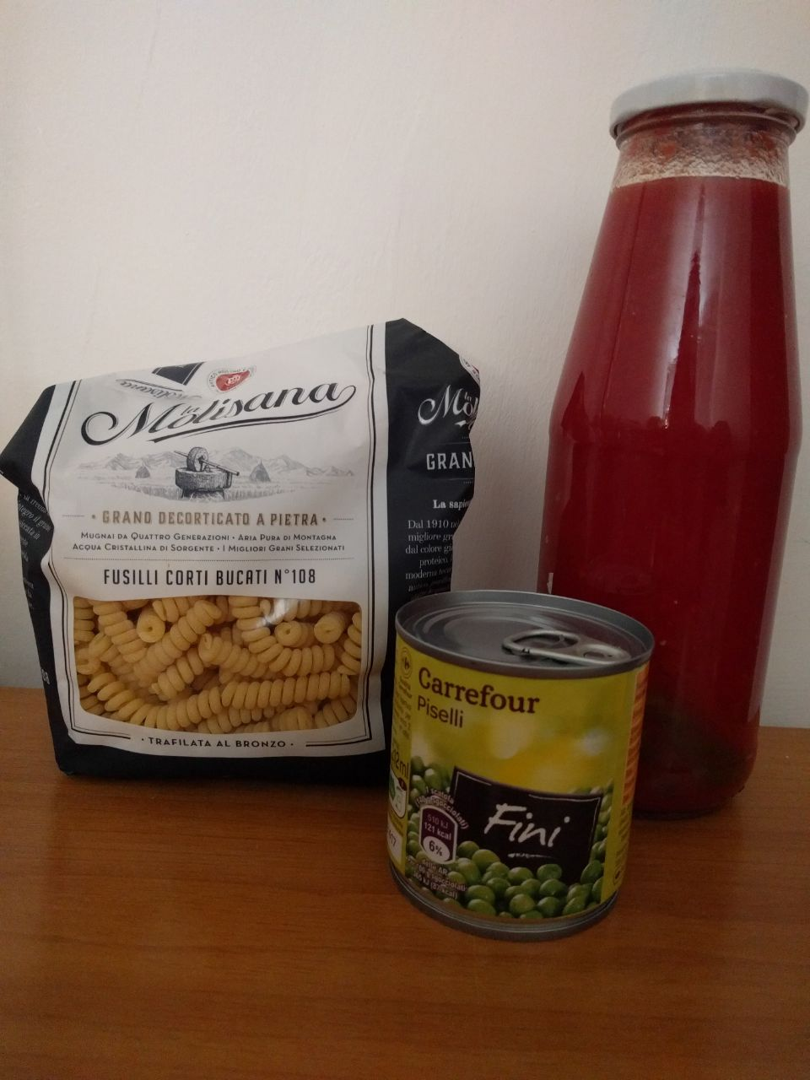
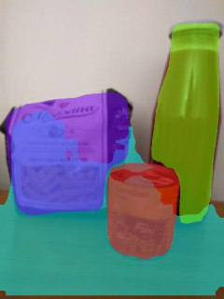
Image segmentation and recognition
Generated List:
'beans': 0.7679
'corn': 0.6079
'tomato sauce': 0.4357
'nuts': 0.5579
Notes:
We said that the server perform a semantic segmentation using the state of the art technologies, and recognizing each single product using a specifically trained Convolutional Neural Network, built with the help of the TensorFlow library.
So as an example you can see a picture taken inside the fridge of some common products
On the right you can see the list that you obtain as you will have in your web app

Slide 8
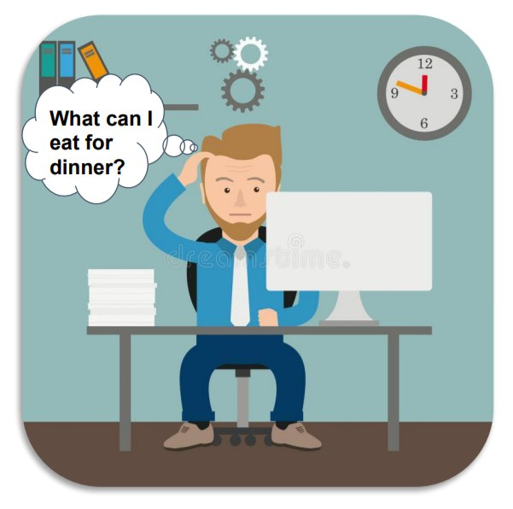
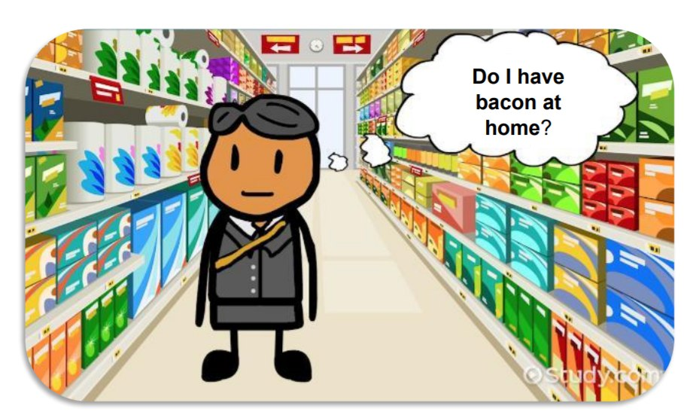
Use case 1 - The story of our life
Notes:
Always Available
The first use case is the story of all our lives:
While we work or study, a question come up on our mind: what can I eat for dinner??
Or think about when you are at the supermarket and you have to buy the food..
Of course you don’t remember what you have in the fridge exactly because probably you went to the market some time ago!
Luckily that time you put the stuff in the fridge and our system acquired and processed the data.
Let’s see an example of this availability in the web app:
a@b.it is a demo account
login e see list and this is the product that he has in all his storage units of the house
FINE
Sei a lavoro o al supermercato ma non sai cosa hai in frigo
Per fortuna qualche giorno fa hai messo i prodotti in frigo/dispensa
Prendi il cellulare, apri l’app e hai tutto quello di cui hai bisogno
In più hai poca fantasia ma sei di fretta al supermercato
Ti servono ricette decenti per la sera
APP!
se sei al supermercato ti serve la ricetta per decidere cosa comprare
se sei in ufficio vuoi consiglio per mangiare

Slide 9
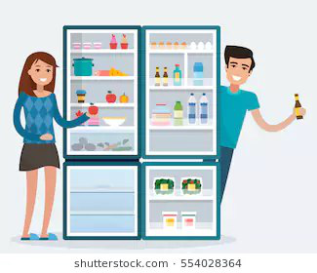
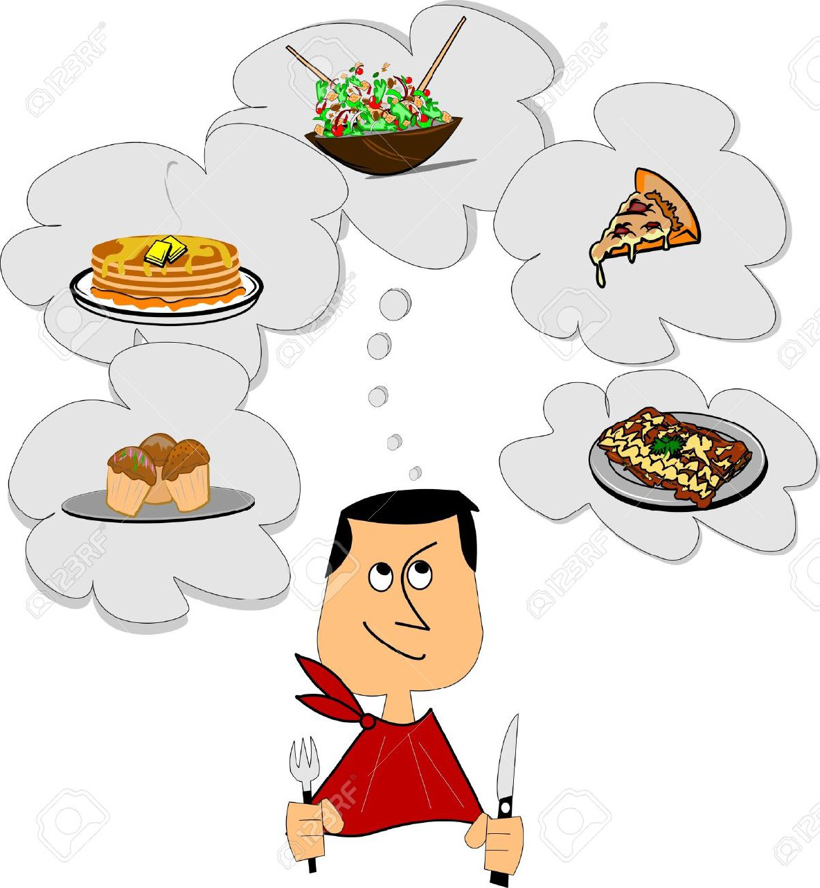
Use case 2 - Recognition and advice
Notes:
At this point there is another use case:
Recognition and advisor
first recognition:
Let’s try an example: he is Mario Rossi.
Now
He just get back from the supermarket and he bought some food.
He puts them in the storage units and asks himself about what to cook tonight
So now the system is taking the picture of what we have inside and it’s sending it to the server
Let’s give a second to this process…
Now we update the list: the system made a recognition of what we have inside the fridge right now.
Let’s think that mario is thirsty and he wants to make him a cup of tea
He took away the tea from the fridge.
Now he ask himself what can he prepare for dinner tonight?
He just need to go back to the web app, update the list that now will not have the tea
and just clicking on recipes we ask to the food2fork API to gives us some advice about the recipes we can make starting from the products we have.
FINE
While we can see the web app that you will open on your browser / mobile phone
(parla app: è in react, bootstrap, user friendly
fai login (o ti registri se è la prima volta) and you arrive to page with the list
Once you have the data, you reload the list pushing that button
and you can see the list updated with the products that he just inserted
it’s a demo so of course there are some errors as you can see but we will see some future improvements further

Slide 10


Use case 3 - Installation
Plug in
Push WPS button
Add it to your devices list
That’s all folks!
Notes:
Last: how can we install the system??
You will be surprise on how easy it is
you just need to plug in the cable, push the wps button on your home router, add the device and that’s it
we can’t show it now because we have already connected the rasbperry of the fridge
and moreover we don’t have an access point with wps.
we tested it at home

Slide 11

Future goal: make it smarter
Hardware view:
more cameras in one shelf
use a magnetic sensor instead of the light one
Software view:
integration with google, amazon shopping
management of a shared list of products
shopping advisor
give more information on the products
Notes:
We thought about some future improvement that we could do using the architecture and information we have.
From the hardware view:
insert more cameras on the same shelfs to have a better view
insert a magnetic sensor to improve the understanding of when to take a pictures
From the software view
We would like to integrate with google??
We could think about a shared list between flatmates
We could integrate the app with an advisor that suggests you the shop to do based on your habits
Create a way to insert the expiration date
Integration with amazon for the shop

Slide 12
Thank you
Mobile and Cyber-physical System
25/05/18
Alessandro Fagnani, Federico Rossetto e Silvia Severini
Notes:
Thank you for the attention

